Slide 1
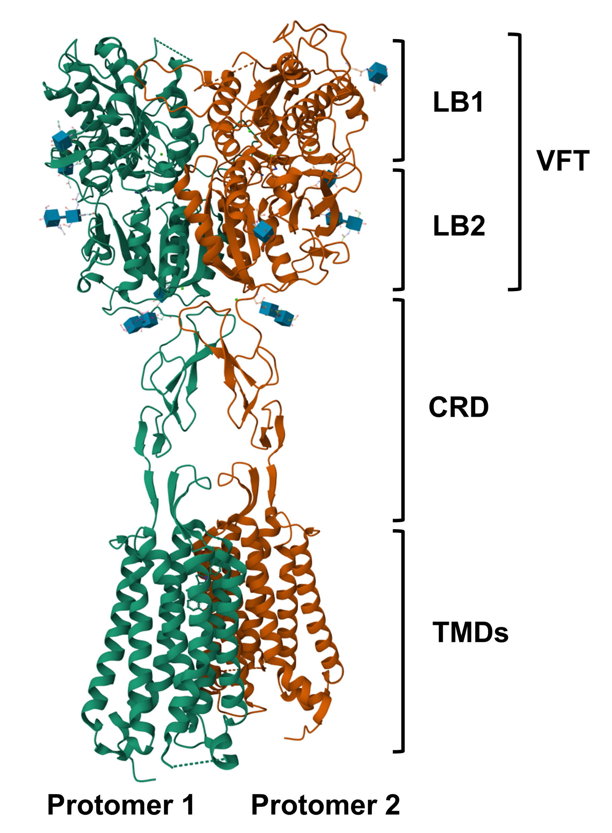
Notes:
Structure of Calcium-sensing receptor in complex with evocalcet, a calcimimetics and derivative of cinacalcet

Slide 2
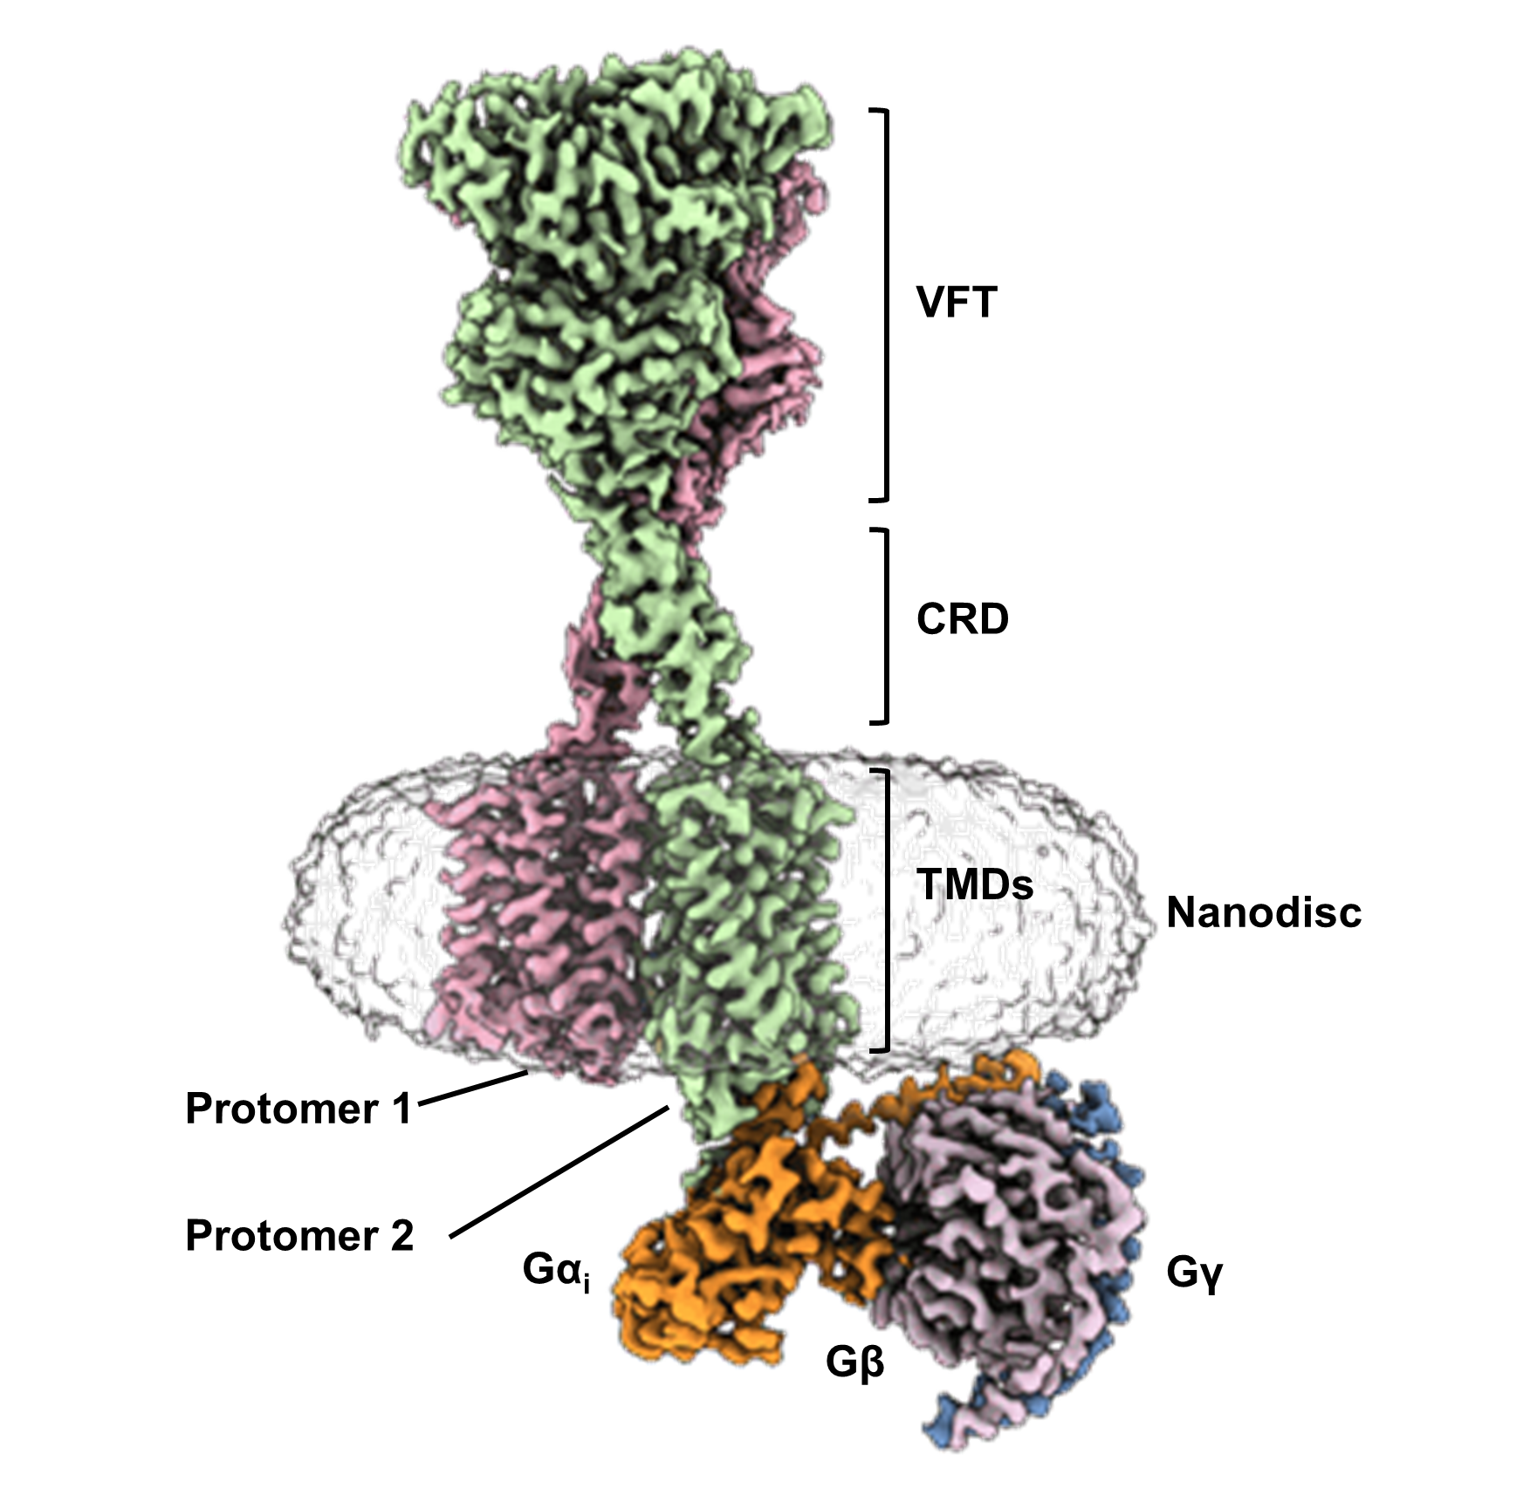
Notes:
Cryo-EM structure of human calcium-sensing receptor-Gi complex in lipid nanodiscs

Slide 3
Notes:
CASR gene structure

Slide 4
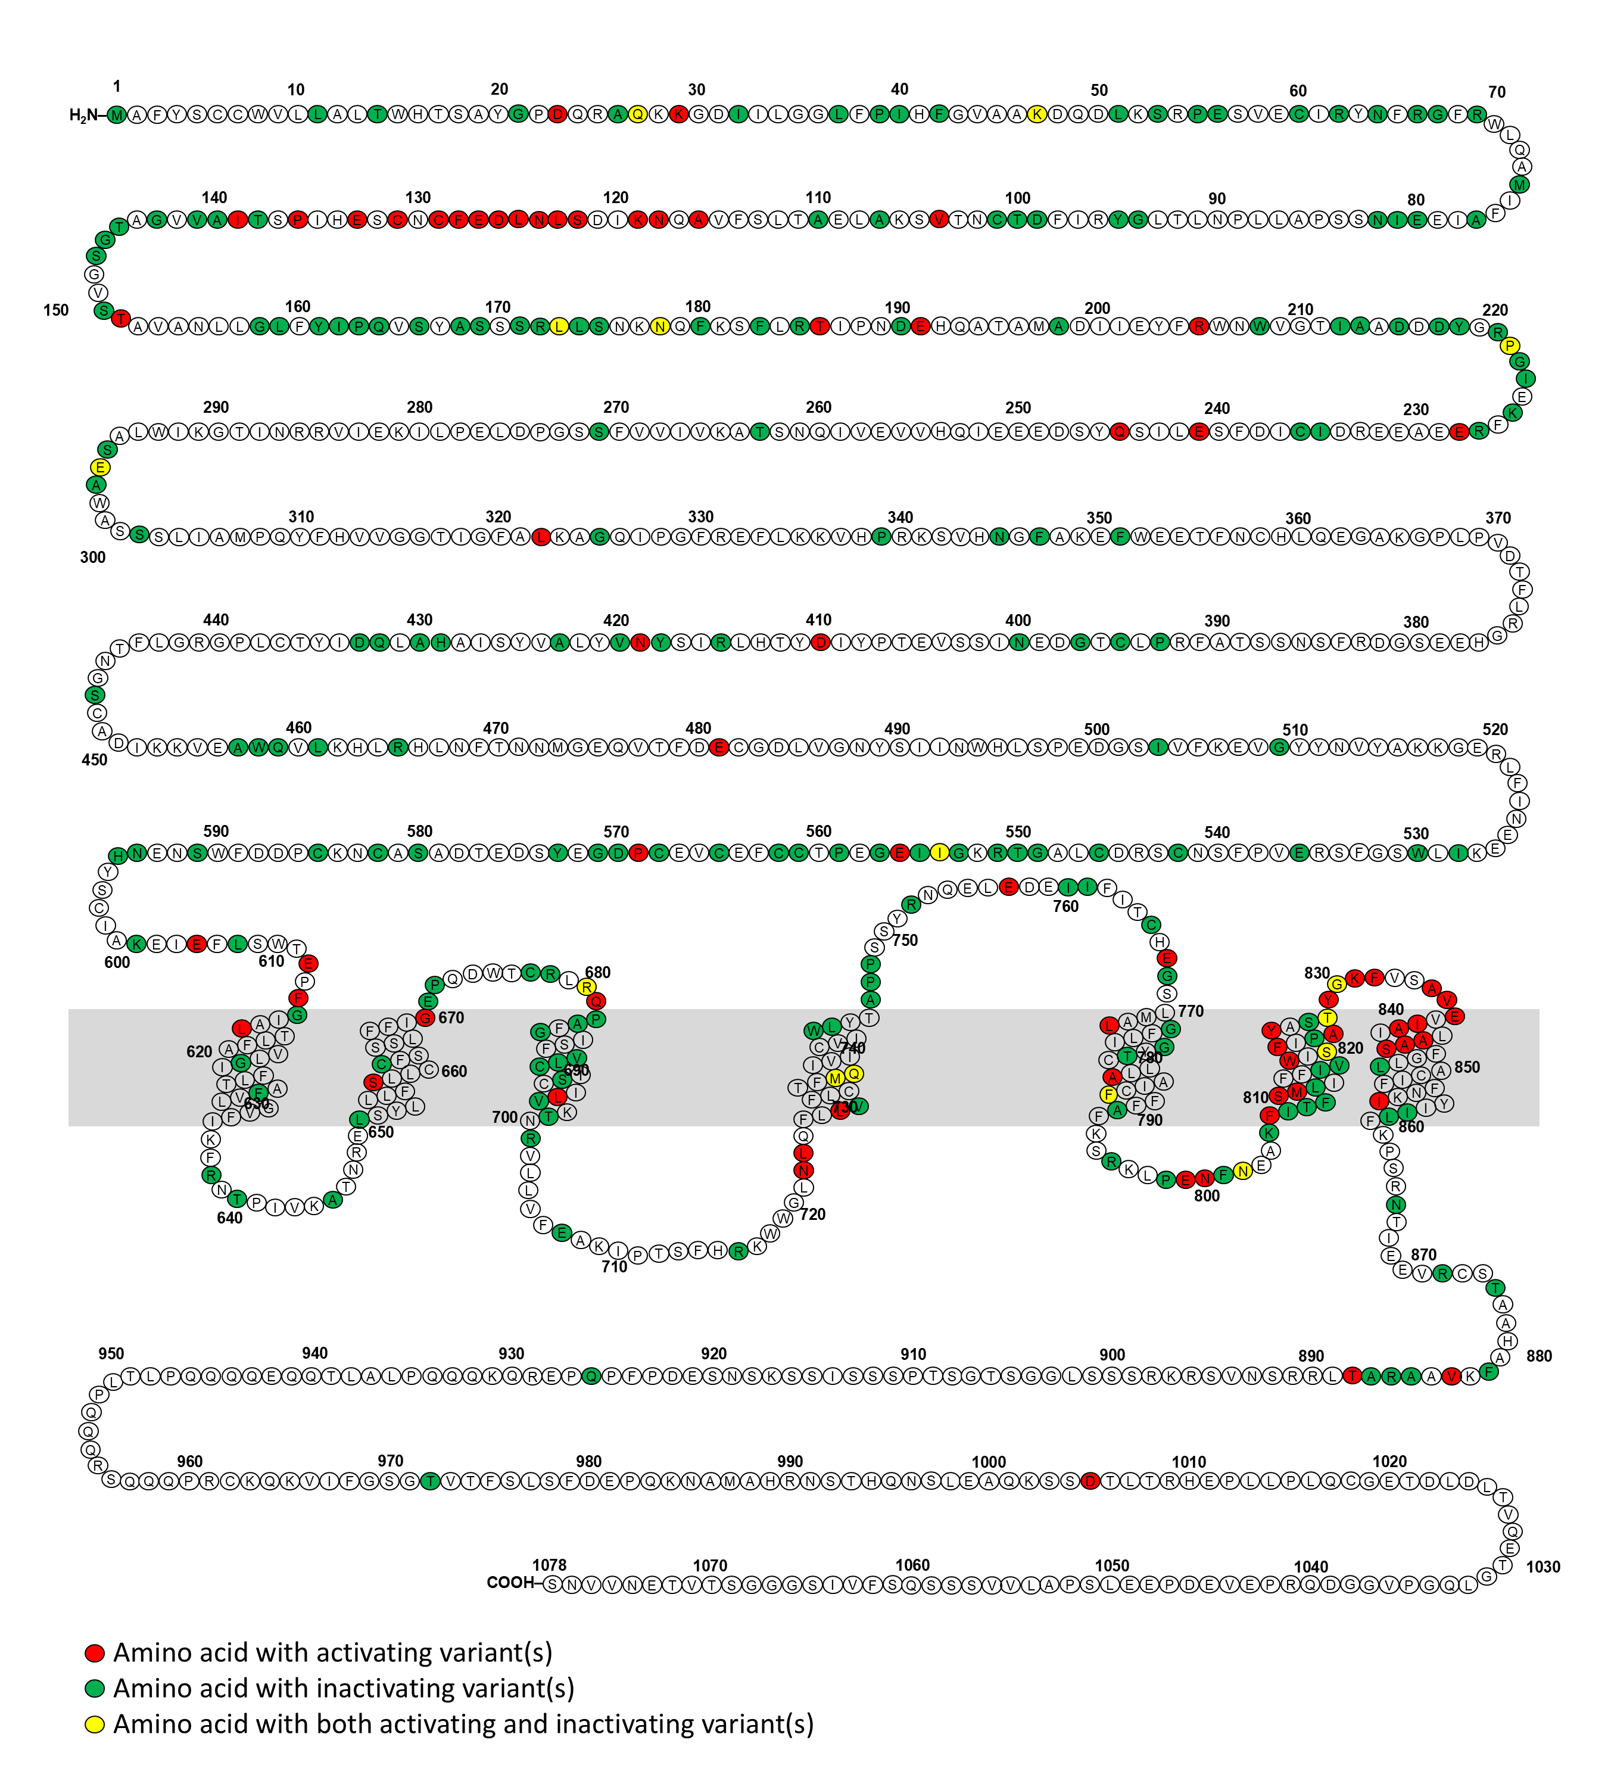
Notes:
Snake missense variants

Slide 5
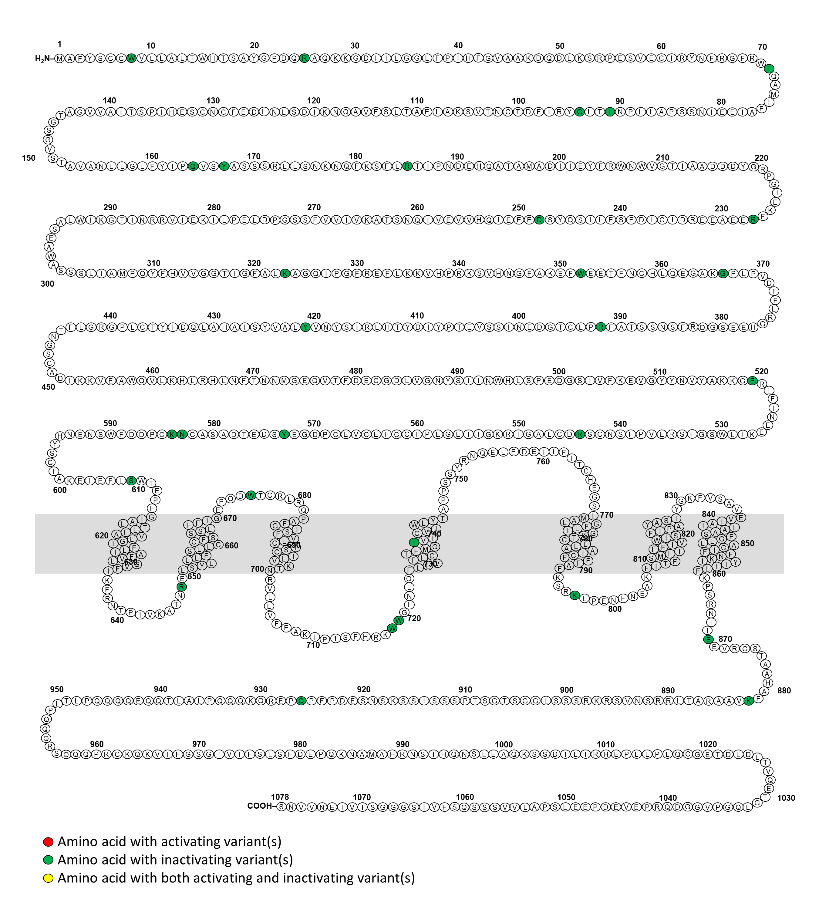
Notes:
Snake nonsense variants

Slide 6
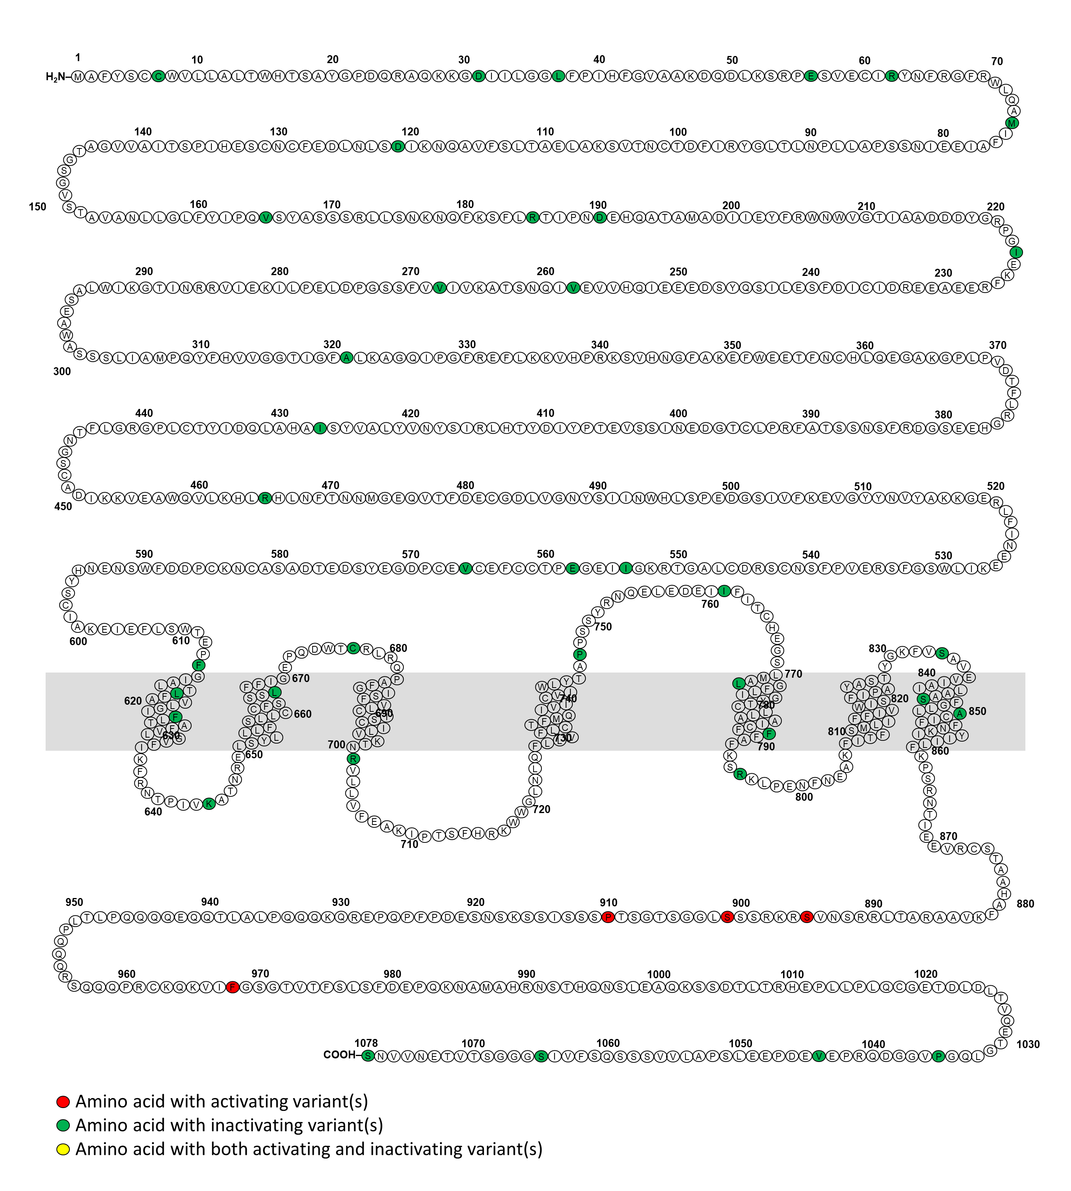
Notes:
Snake frameshift variants

Slide 7
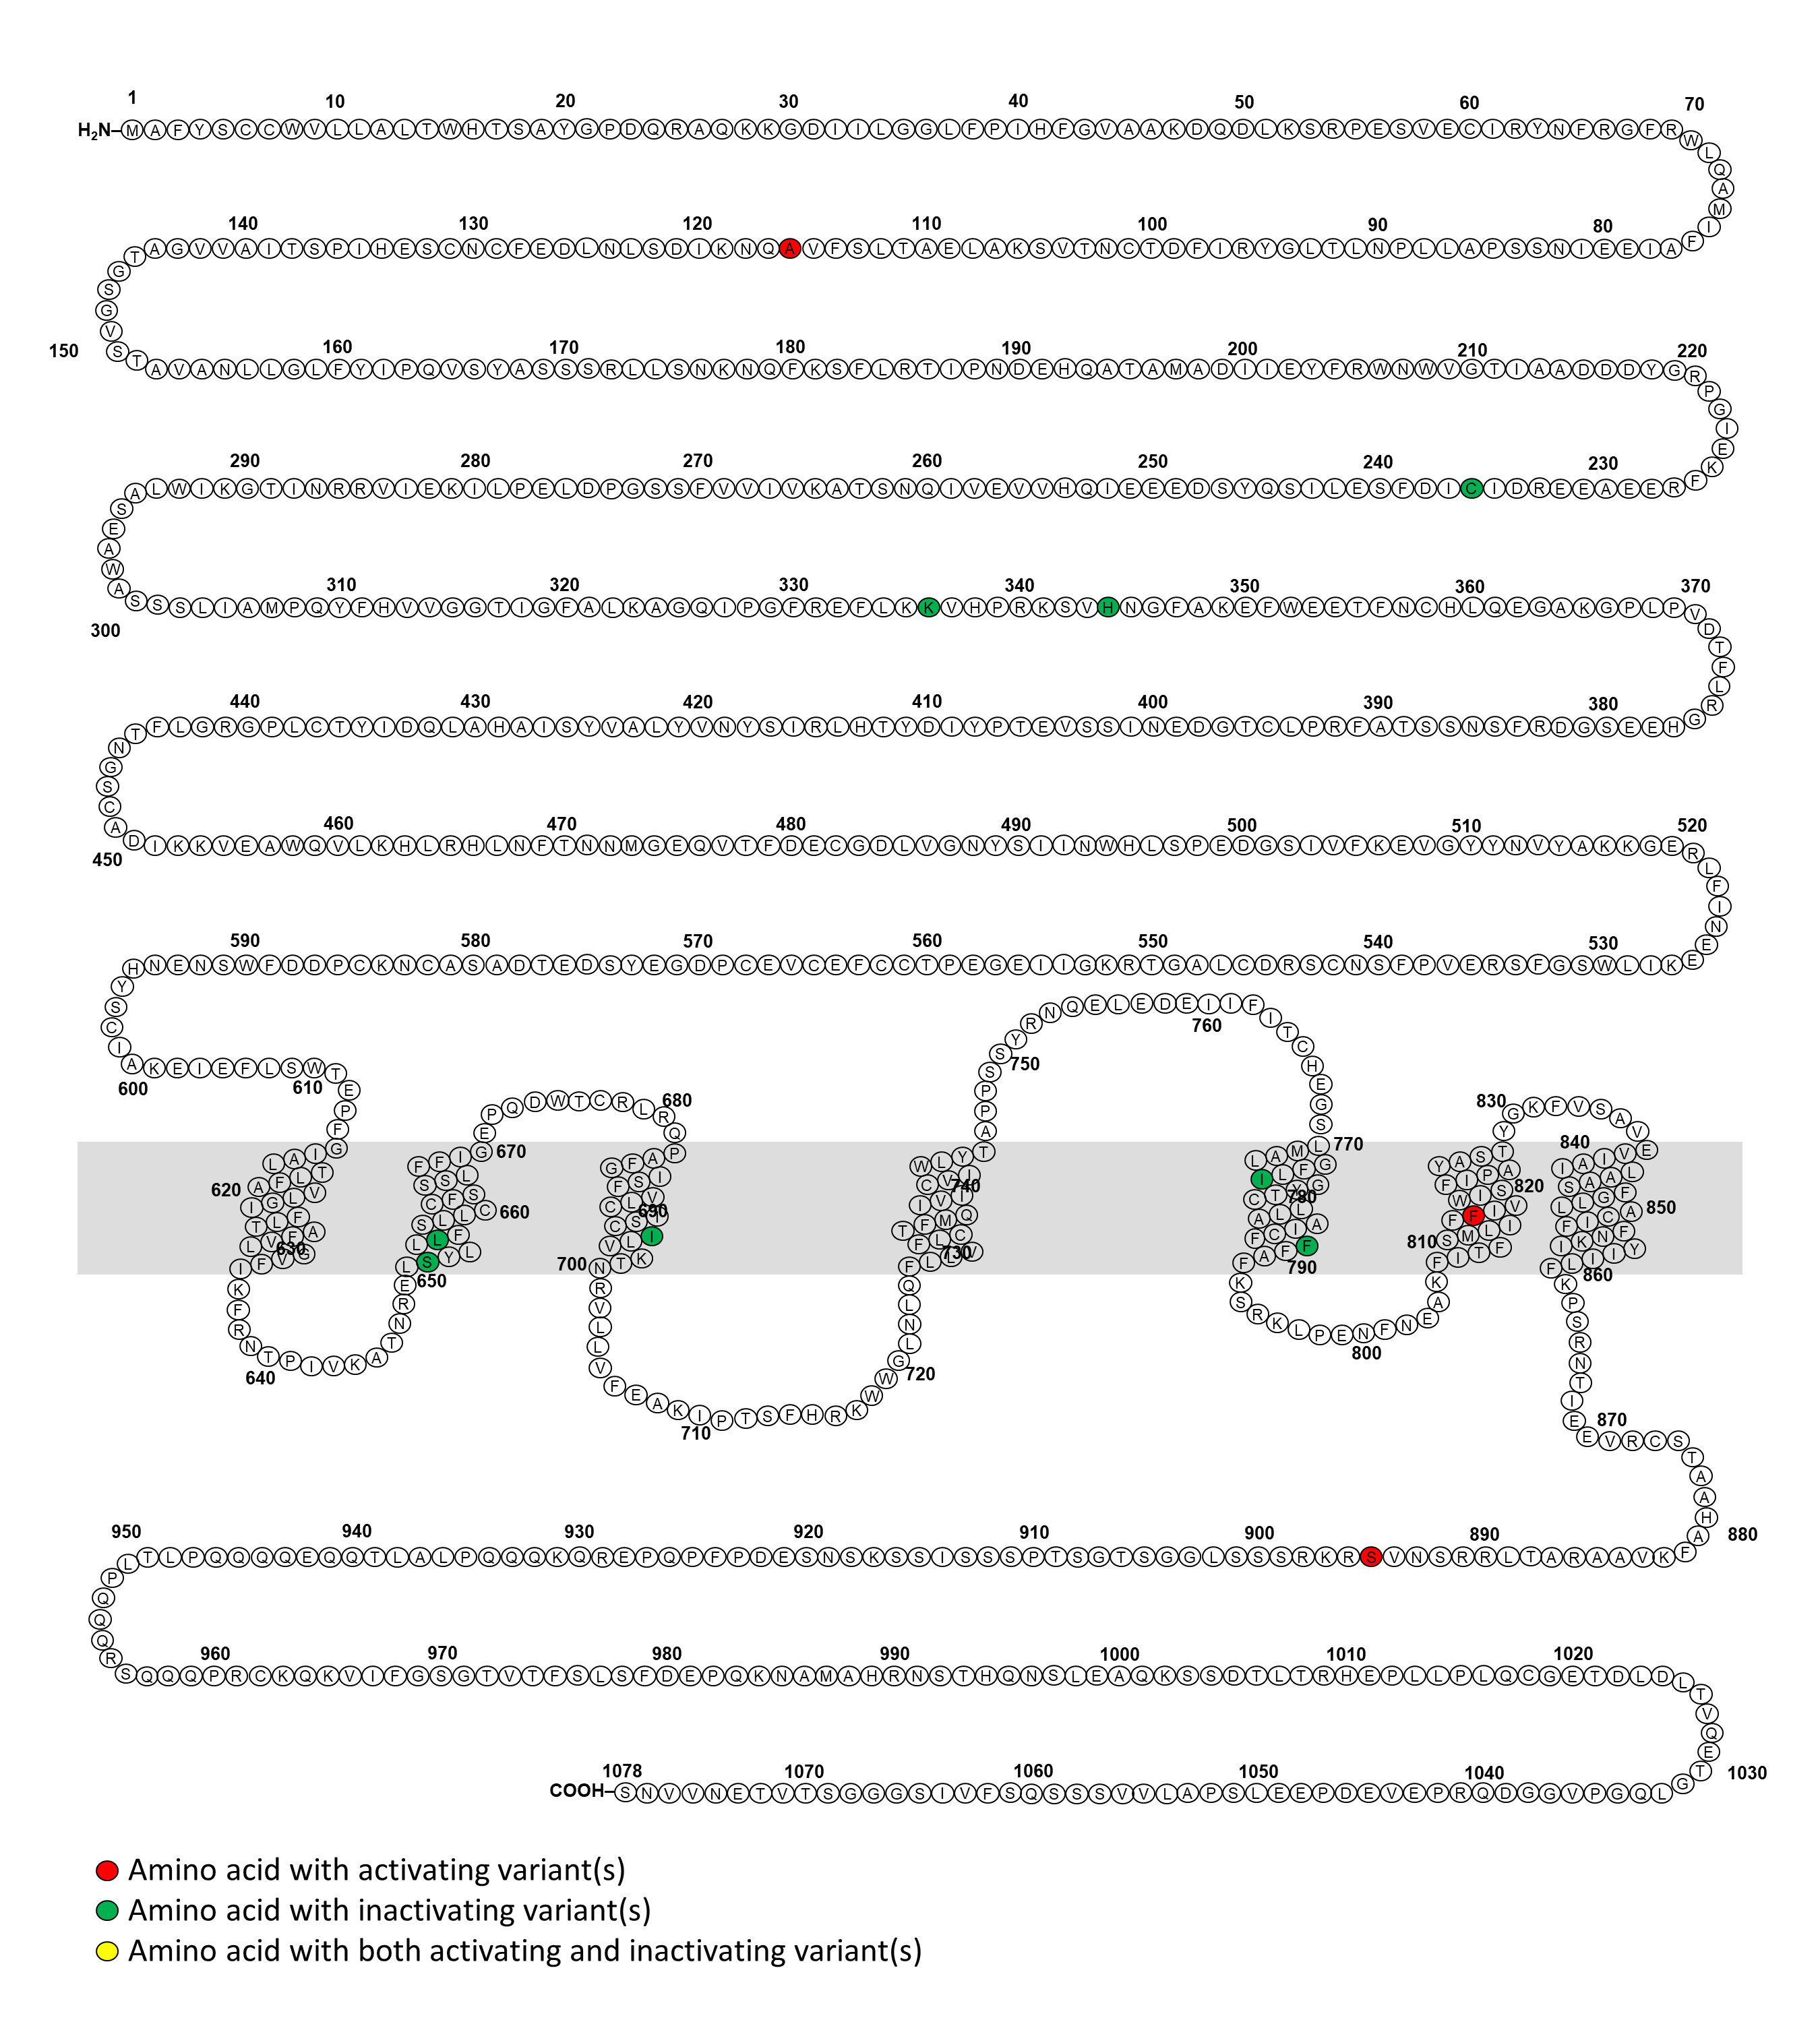
Notes:
Snake insertional/deletional variants

Slide 8
Notes:
CASR gene structure

Slide 9
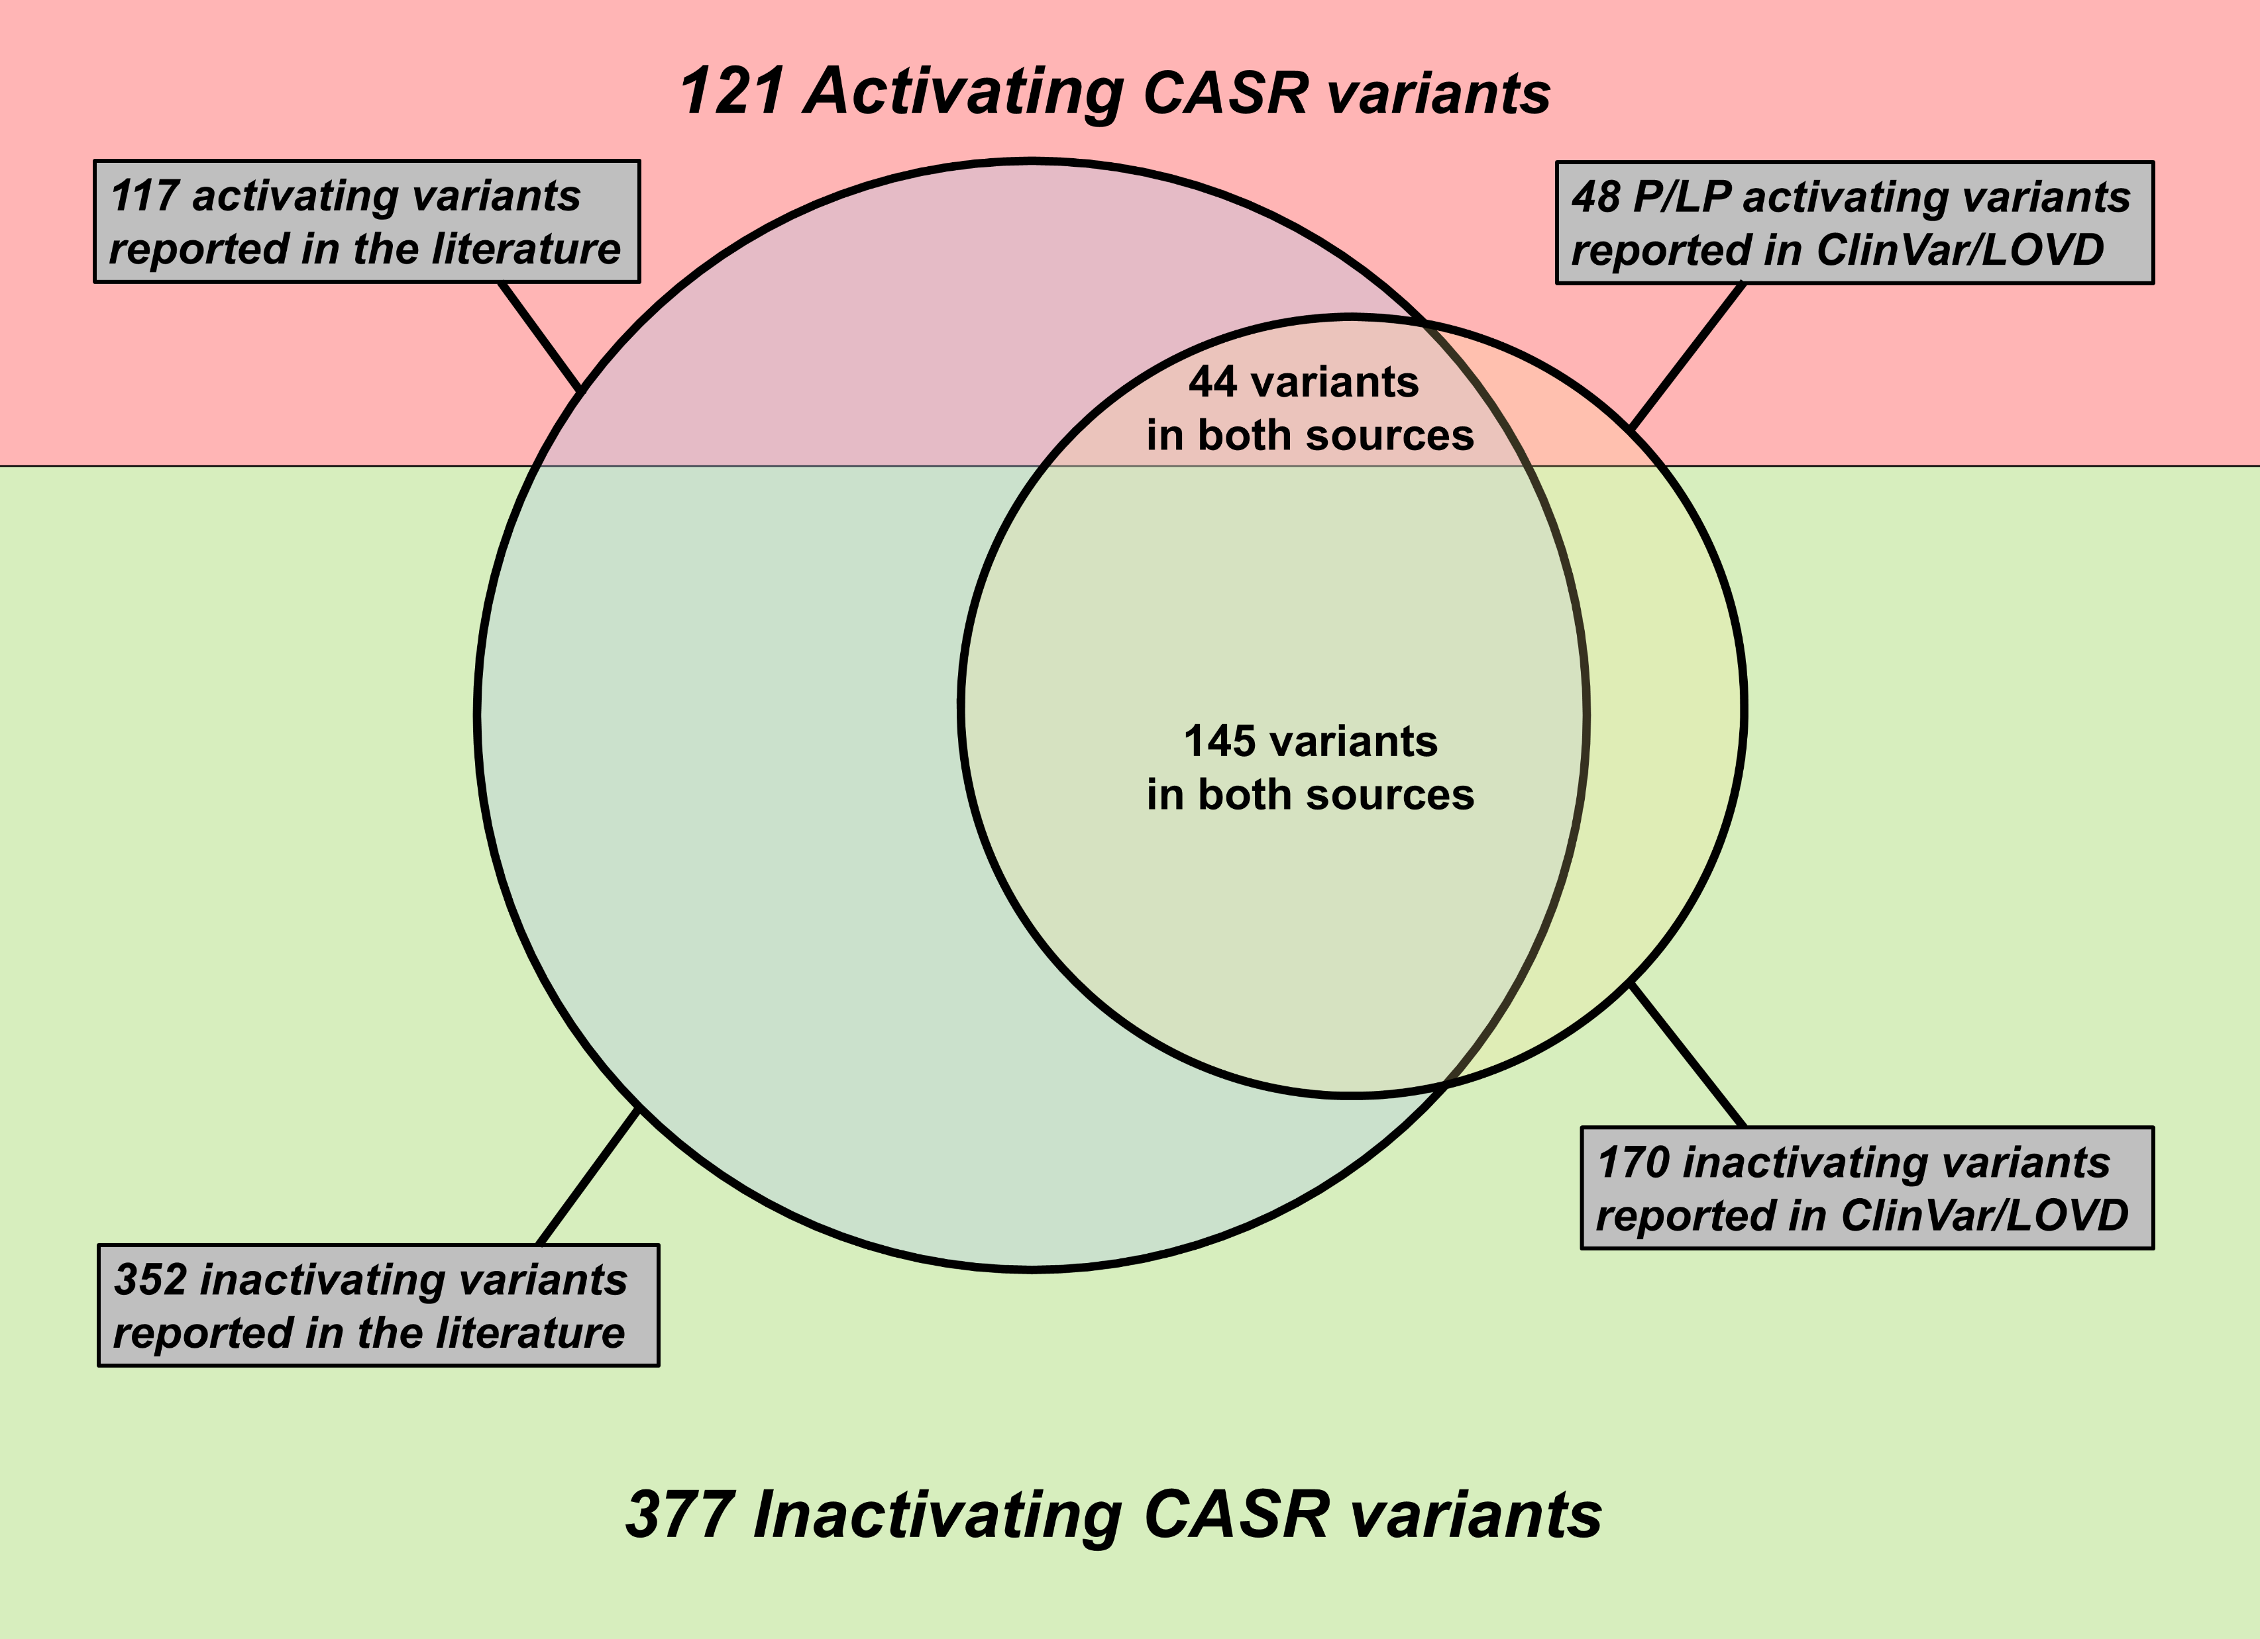
Notes:
Summary of number of variants

Slide 10
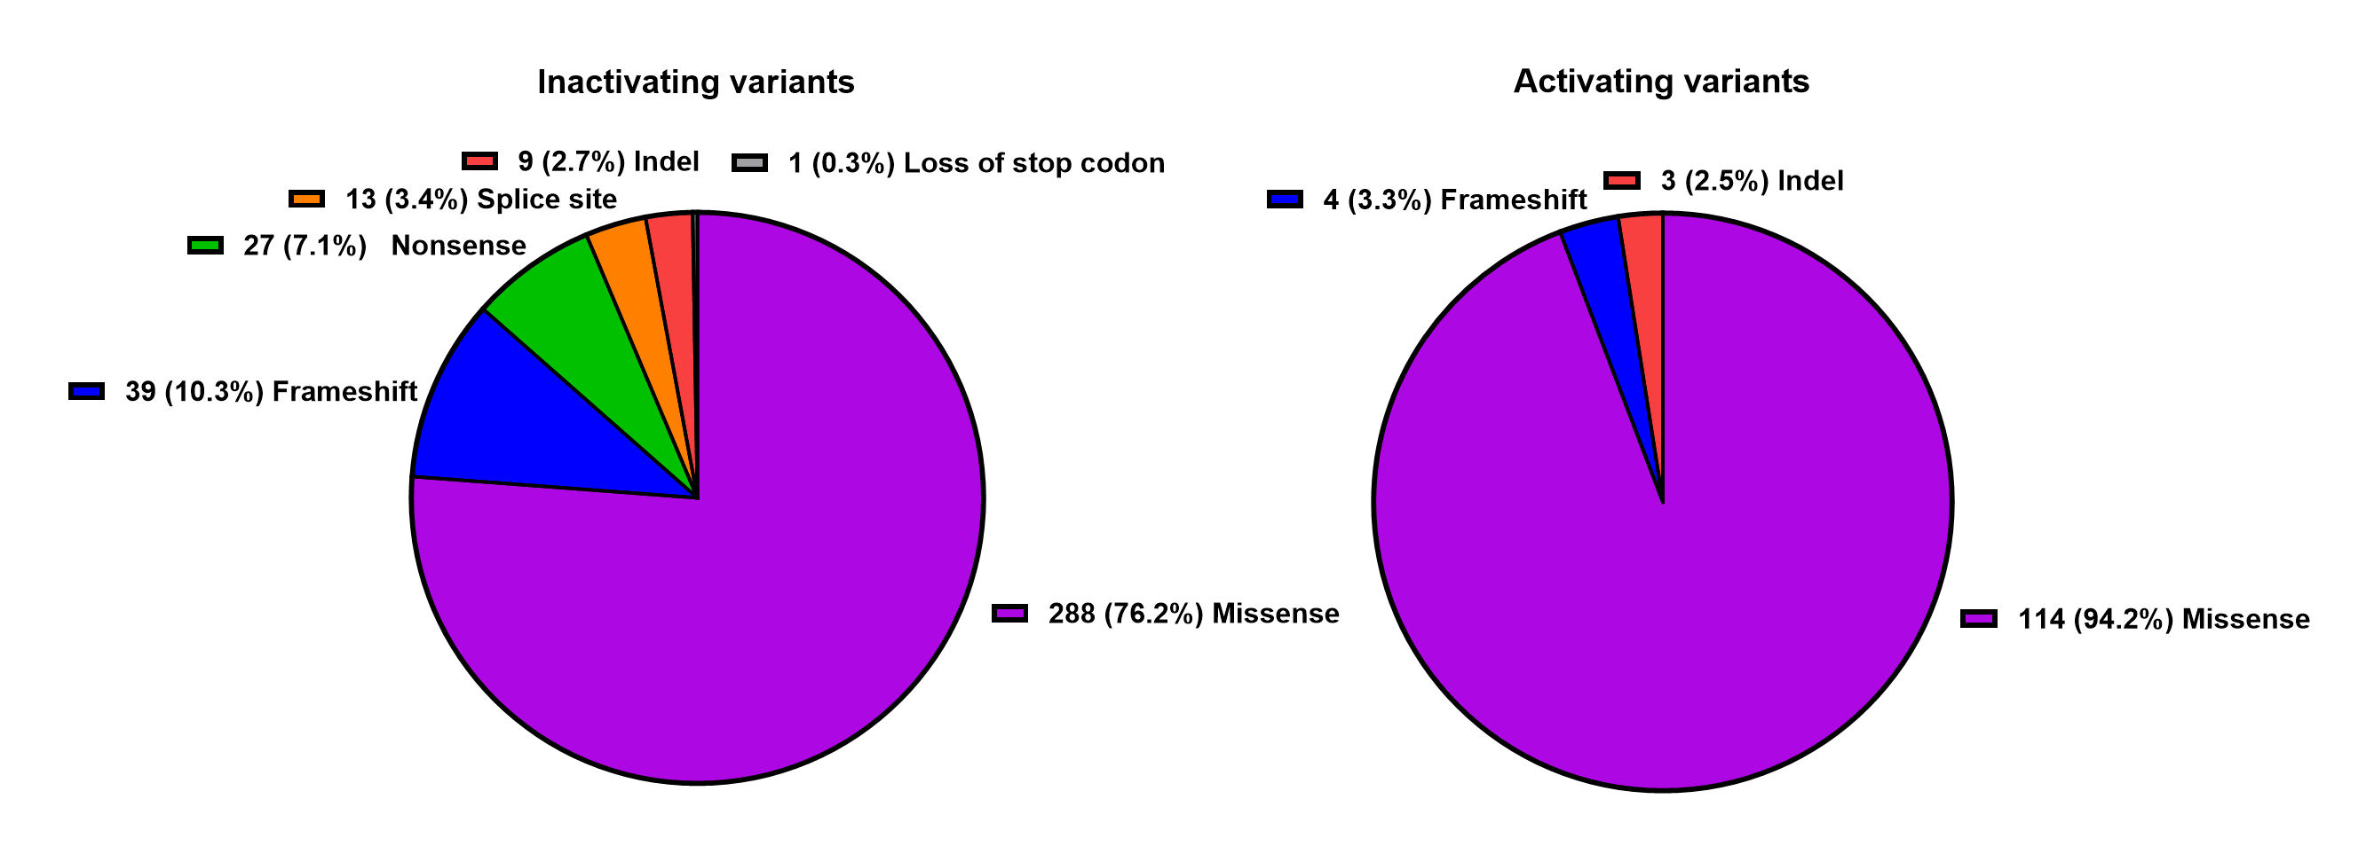
Notes:
Variant count by type

Slide 11
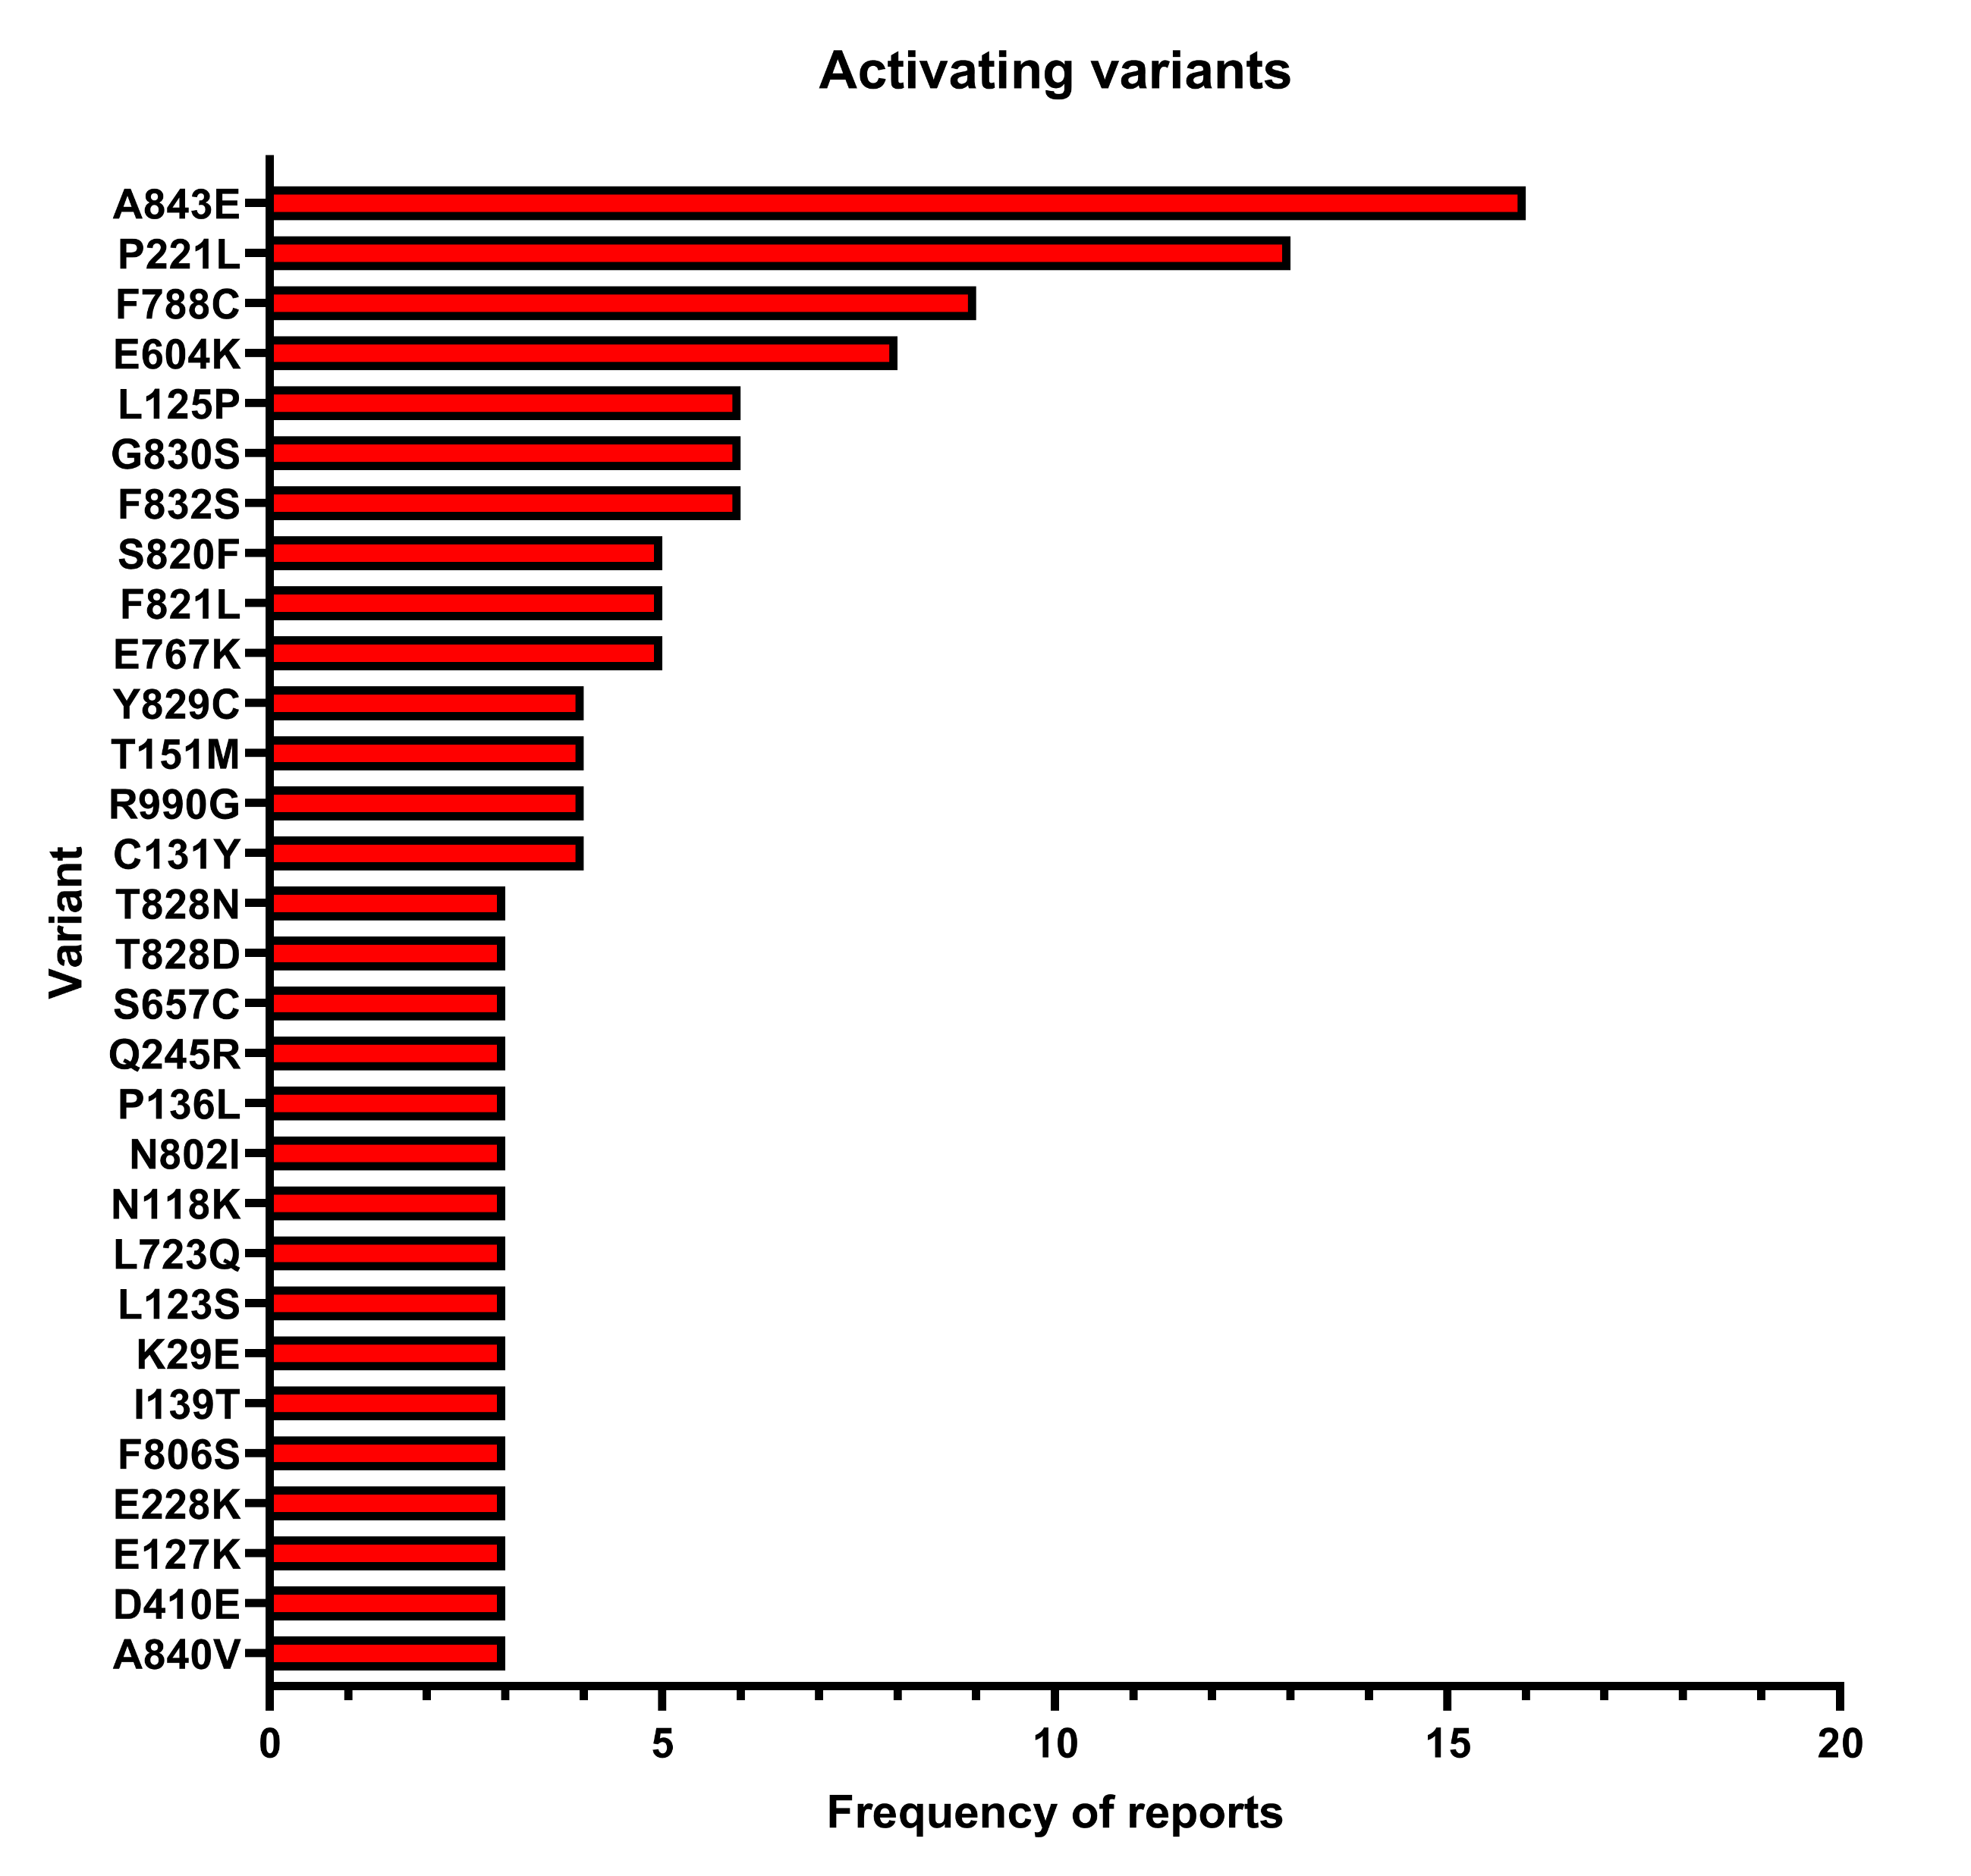
Notes:
Common activating variants

Slide 12
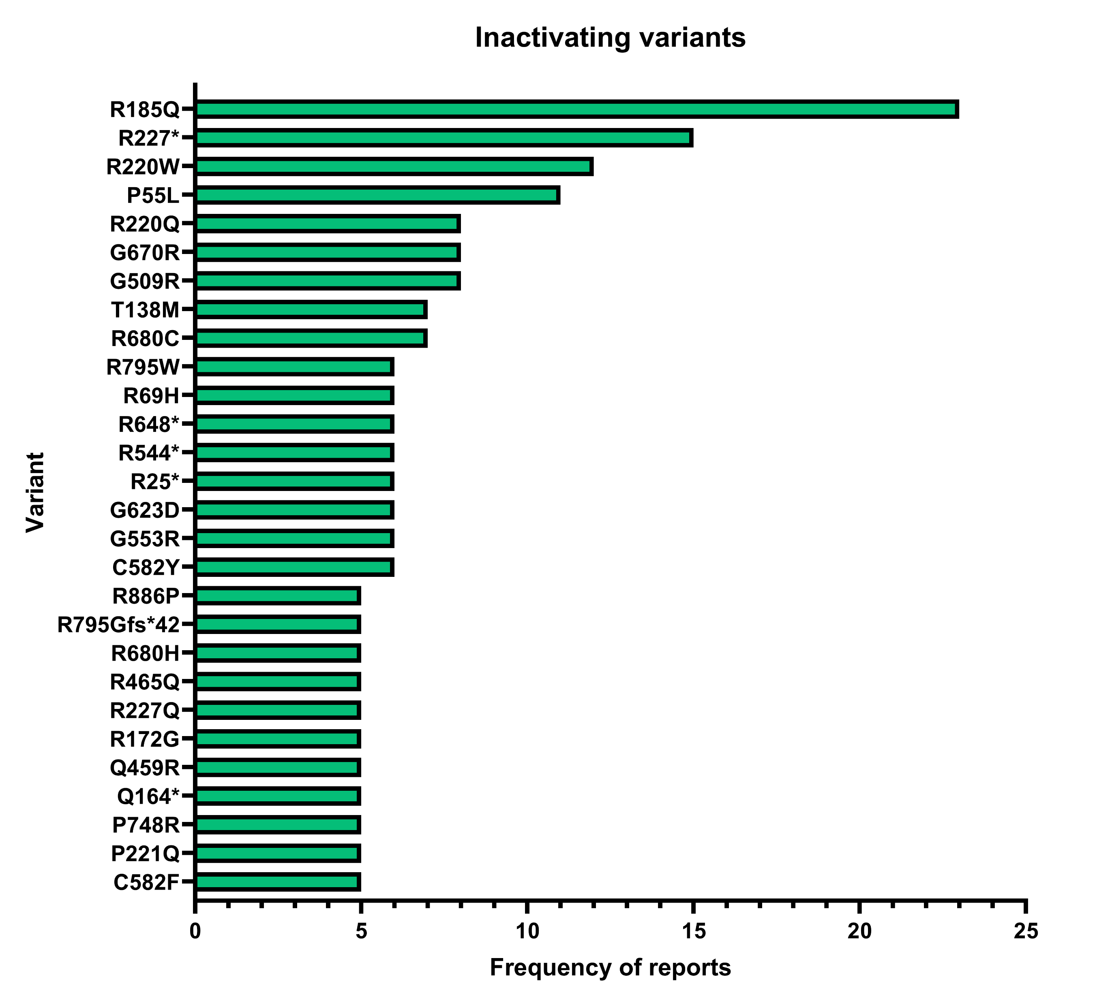
Notes:
Common inactivating variants

Slide 13
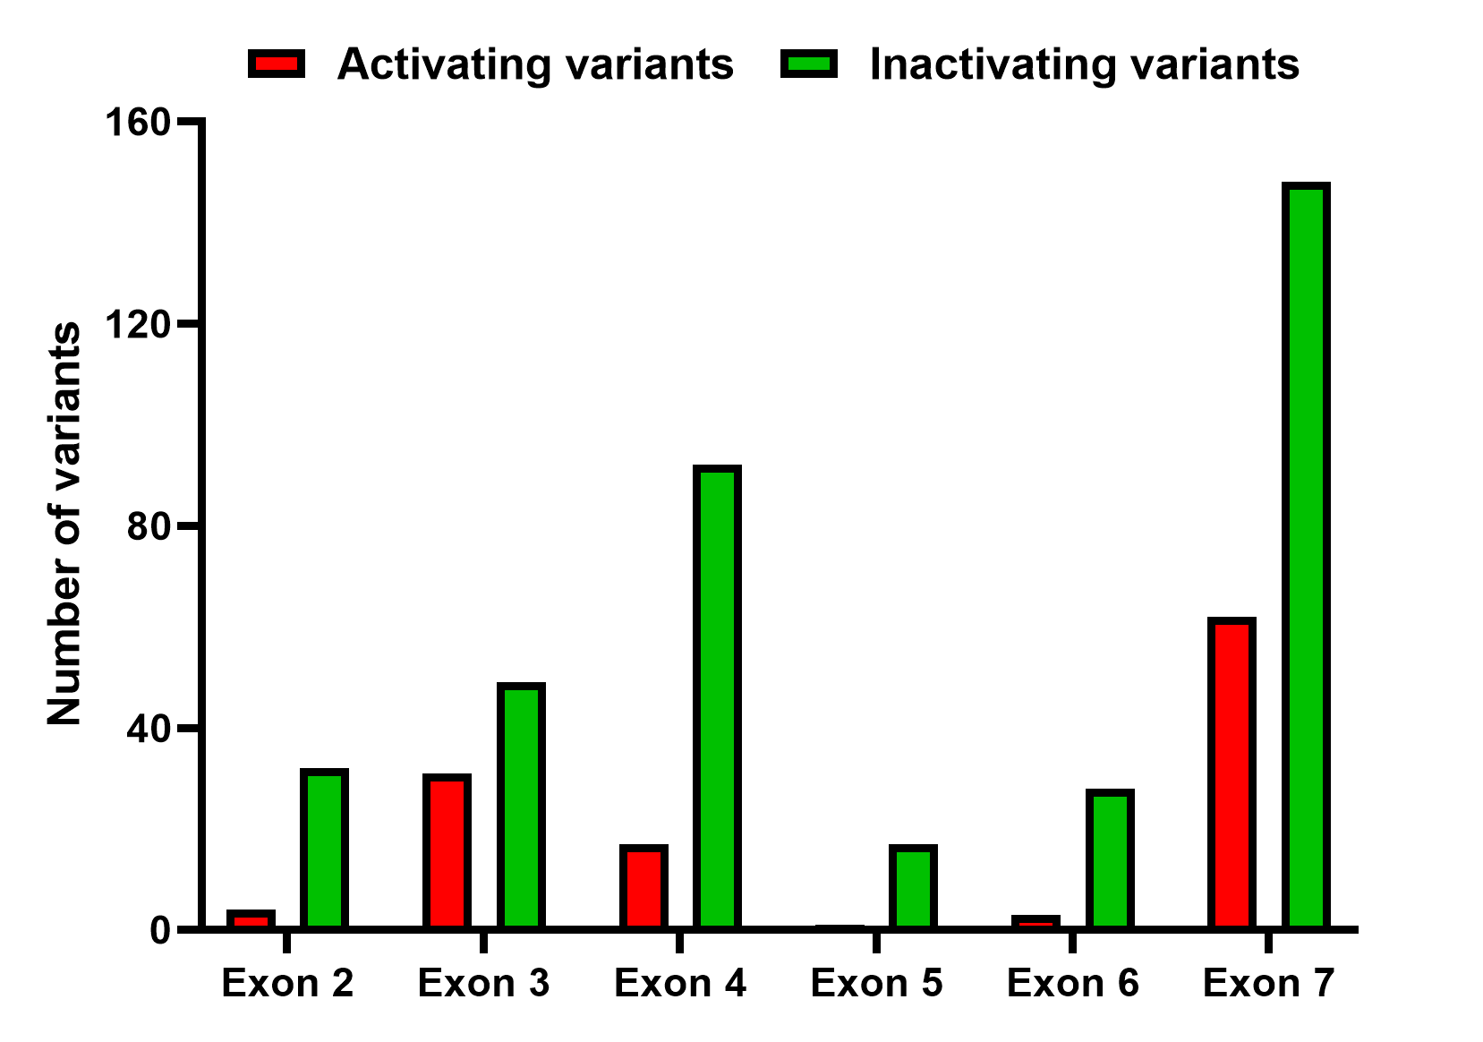
Notes:
Variant count by exon

Slide 14
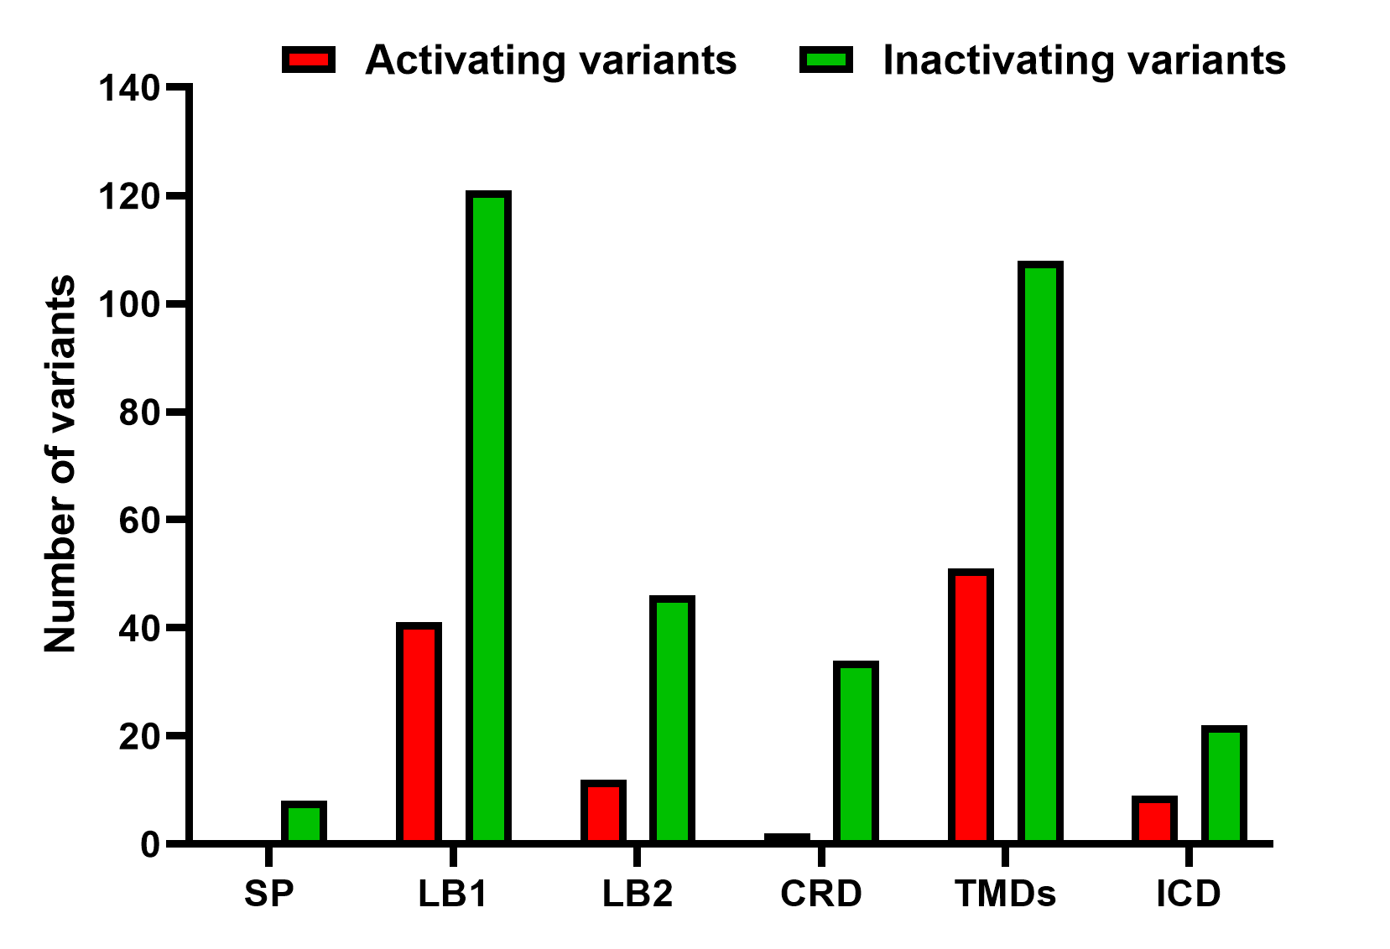
Notes:
Variant count by structural domain

